Slide 1
Update Set Mover Application
Developed by Pedro Leite

Slide 2
Update Set Mover
It’s a simple application that:
allows an extra layer of approval for the Update Set to go to Production and
records all the operations on a table called “Update Set Mover History”
This will allow to:
reduce “update set” pollution on production
more control on what goes to production and
have a better way to track who created, pulled, committed or backed out the updates sets on all instances where this is installed
It is also possible to create reports based on the “Update Set Mover History”

Slide 3
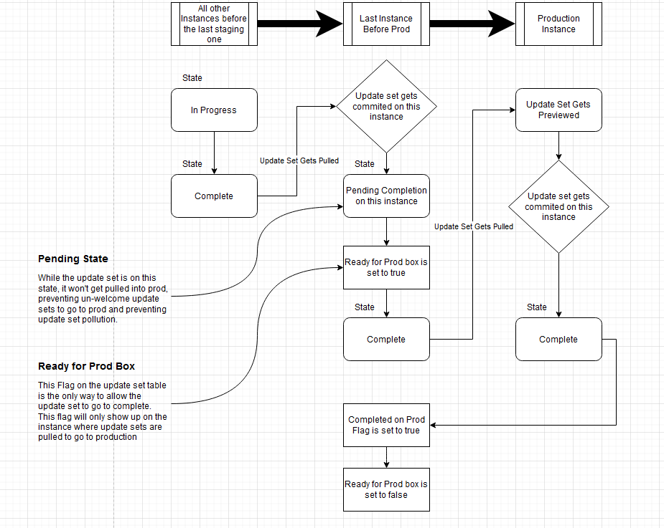
Flow Logic of the Application

Slide 4
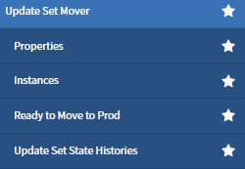
Application Modules
Properties – where you turn on/off the appliction
Instances – where all the instances records should be created. Its crucial for the app to know which instances will use it, name of the production and what instance is set to send update sets for production.
Ready to Move to Prod – List of update sets ready to move to prod for easier / quicker access of information
Update Set State Histories – where all the operations on Update Sets will be recorded

Slide 5
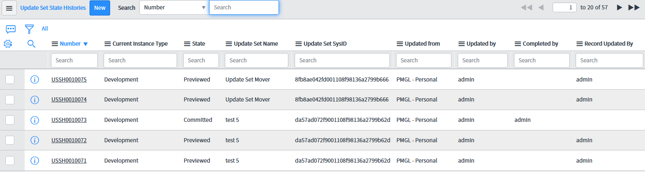
Update Set State History List

Slide 6
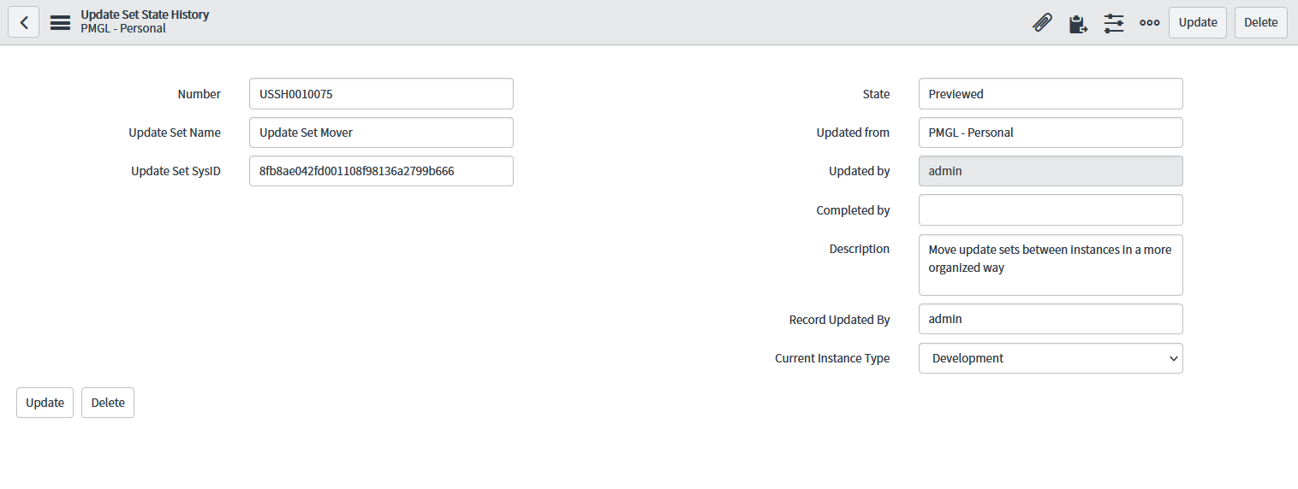
Update Set State History Form

Slide 7
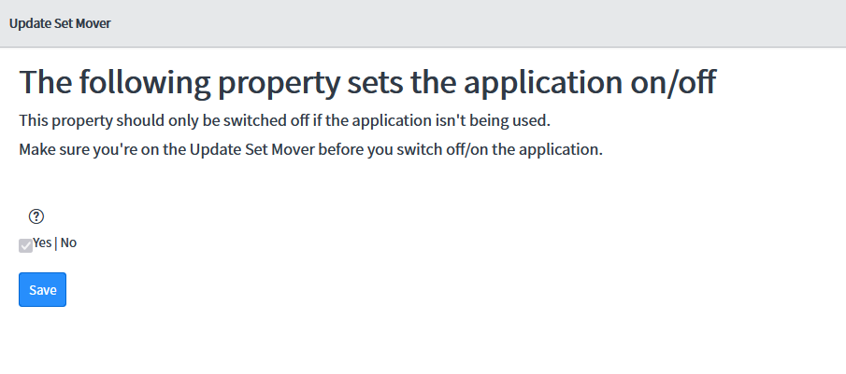
How to turn the application On/Off

Slide 8
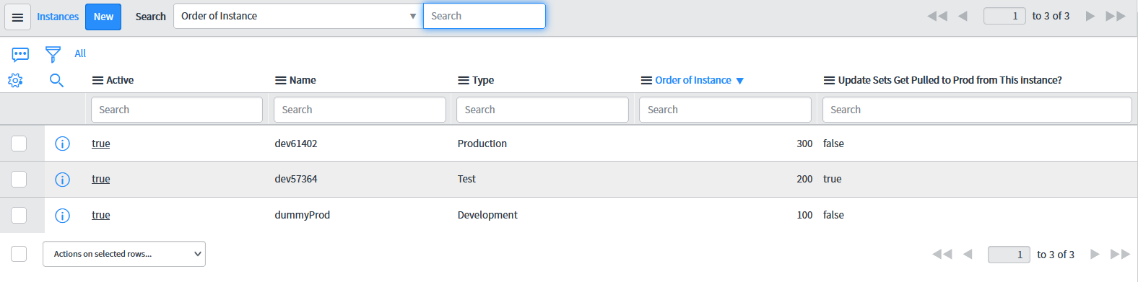
Instances Configuration

Slide 9
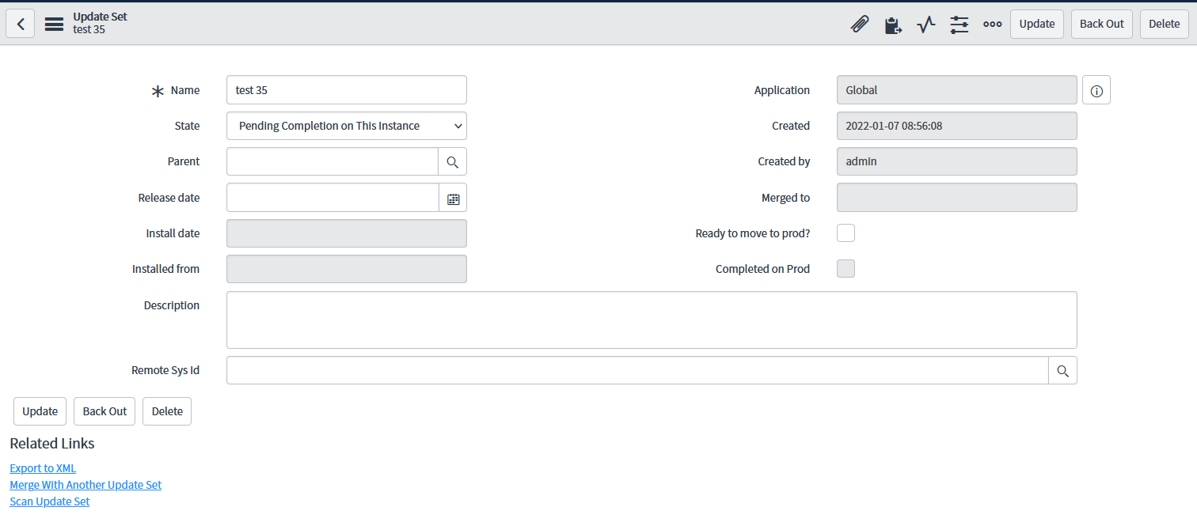
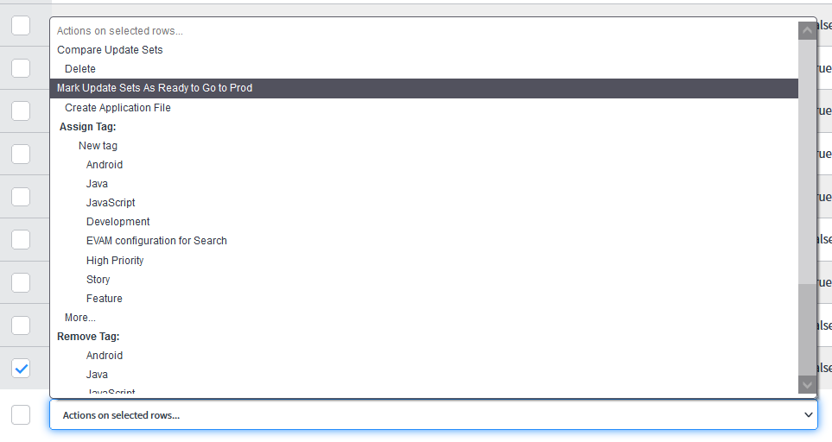
Update Set Record Form
After the Update Set is committed on the instance, its automatically set to “Pending Completion on this instance” and it won’t be possible to be pulled to production until the field “Ready to move to prod?” is manually selected on the record or on the list view
These boolean fields will only show up in the instance set to be “before production”

Slide 10
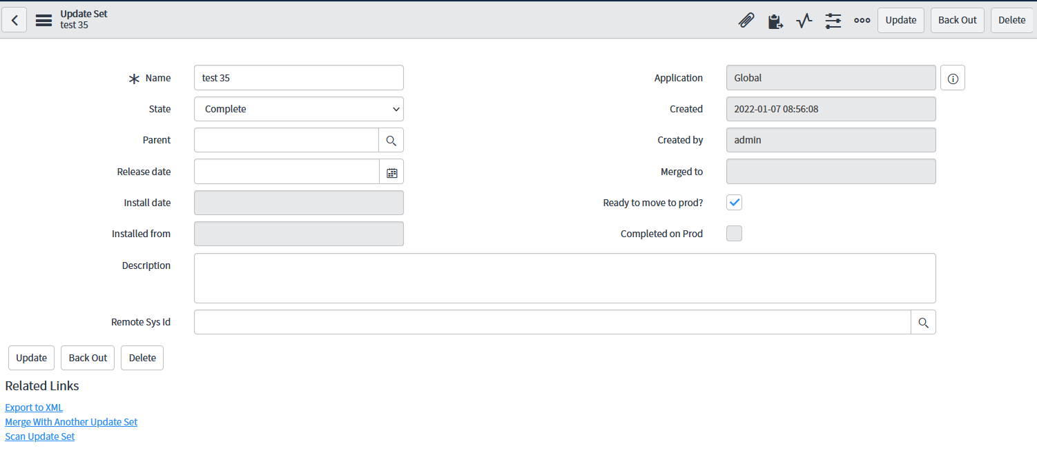
Update Set Record Form
As soon as the “Ready to go to prod?” is selected, the state changes to Complete automatically. Now, the update set is allowed to go to production.

Slide 11

Update Set Record Form
As soon as the update set is committed on production, the update set record is updated automatically on the previous instance and the filed “Completed on prod” is set to true, making also the field “Ready to move to prod?“ false and read-only.

Slide 12
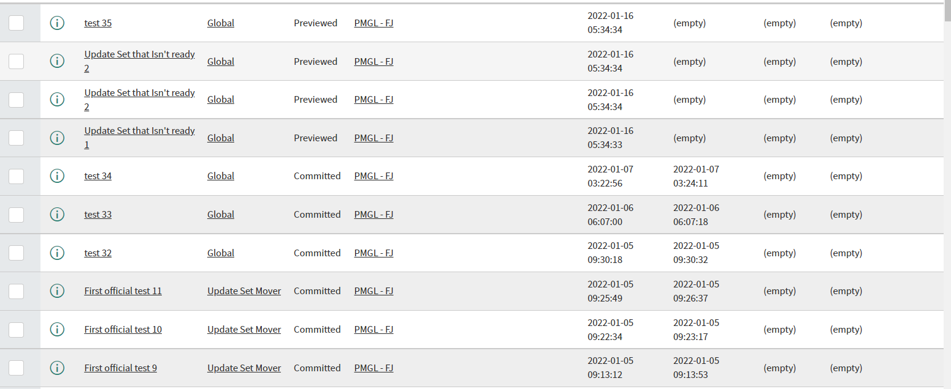
True Purpose of the Application
What we don’t want – Unorganized and Pollution of Update Sets un-welcome on production.

Slide 13
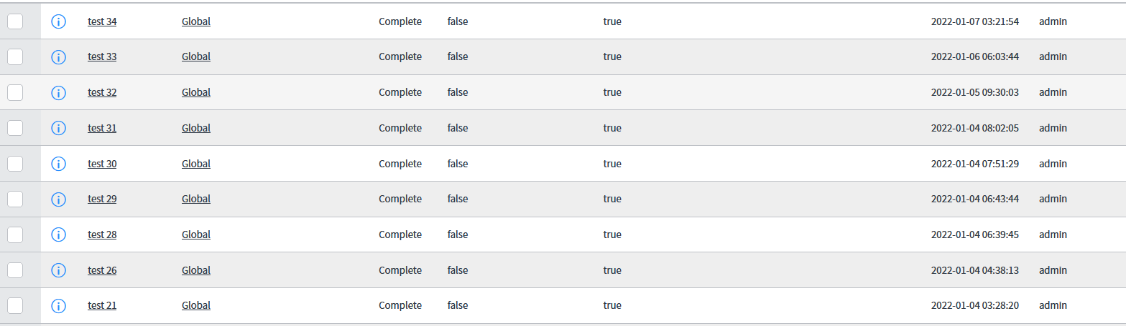
True Purpose of the Application
What we really want – Organized and only trully completed and ready update sets on production

Slide 14

If you have any questions relating to the content of this document, please get in touch:
pedro.leite@fujitsu.com

